Slide 1
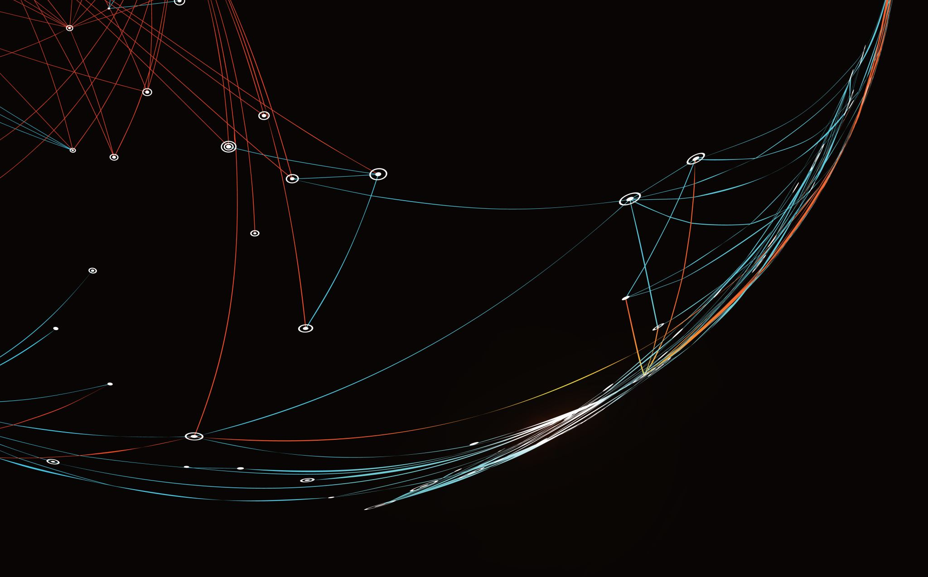
Meeting 6.3.20
Lena & Lishi

Slide 2
Motivating Question
How does the mode of disassembly help actin control its size?

Slide 3

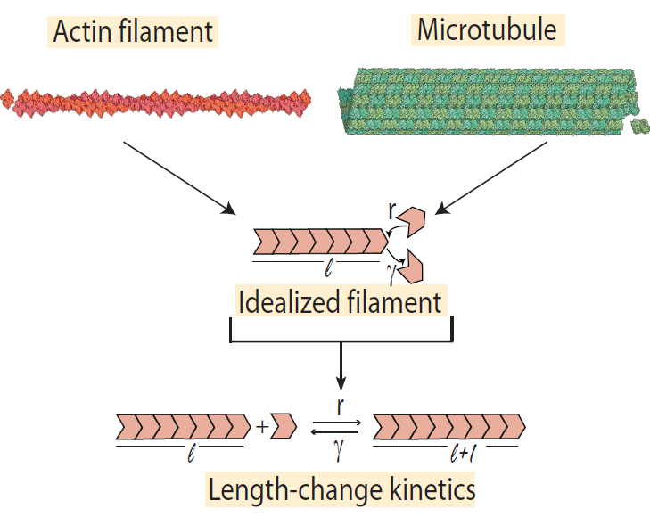
Idealization of Filament
Rate of assembly = r
Rate of disassembly = γ

Slide 4
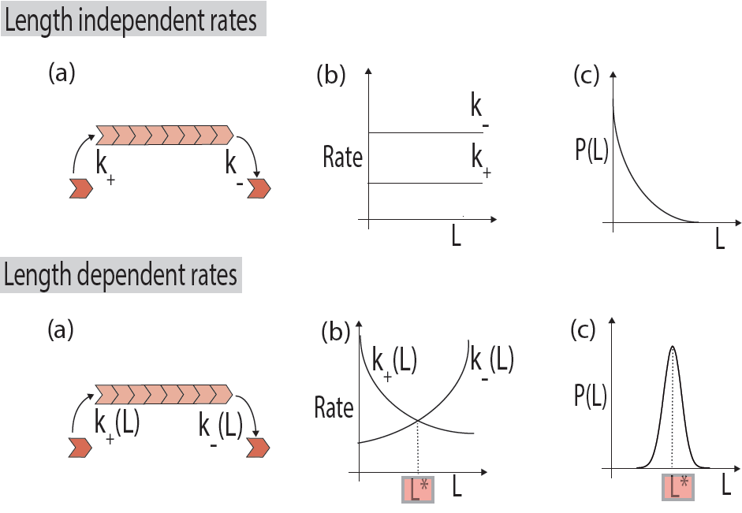
Two possibilities
Rate of assembly > Rate of disassembly
Rate of assembly < Rate of disassembly
How is this related to size control?
r
𝛾
𝛾
r
The filament will shrink faster than it grows, meaning it will SHRINK
The filament will grow faster than it shrinks, meaning it will GROW
If the filament is trying to maintain its size, this will happen when the filament is:
Too Small
Too Big

Slide 5
Unstable!
Stable!
Balancing Assembly & Disassembly
Disassembly
Assembly
Assembly
Disassembly
γ(L)
r(L)
Rate
r(L)
γ(L)
Rate
L*
Length
L*
Length
If we want size control, the disassembly rate must grow with length!

Slide 6
Review: Original Approach
Our original approach was to average the time for ONE depolymerization event to occur at a given length
We then compiled the data from each length and made a “length versus time” plot
This was unsuccessful because the filament was starting “empty,” so the first step always takes longer than subsequent steps
Our initial equations were also wrong because of the way they calculated walk time

Slide 7
Faster association, additional diffuse time (slower for individual protein, faster at high concentration)
k(On)+k(Off)
k(On)*(Number of Monomers)+k(Diffuse)+k(Off)
ONE protein landing, diffusing, falling off
Do this many times for each monomer→ Avg time for a protein to diffuse to end of filament of this length
Do this many times for each filament→ Avg time for a protein to diffuse to end of filament of multiple lengths
MULTIPLE proteins landing, diffusing, falling off (once ONE protein reaches the end)
MULTIPLE proteins landing, diffusing, falling off (once ONE protein reaches the end)
Concentration
Length

Slide 8
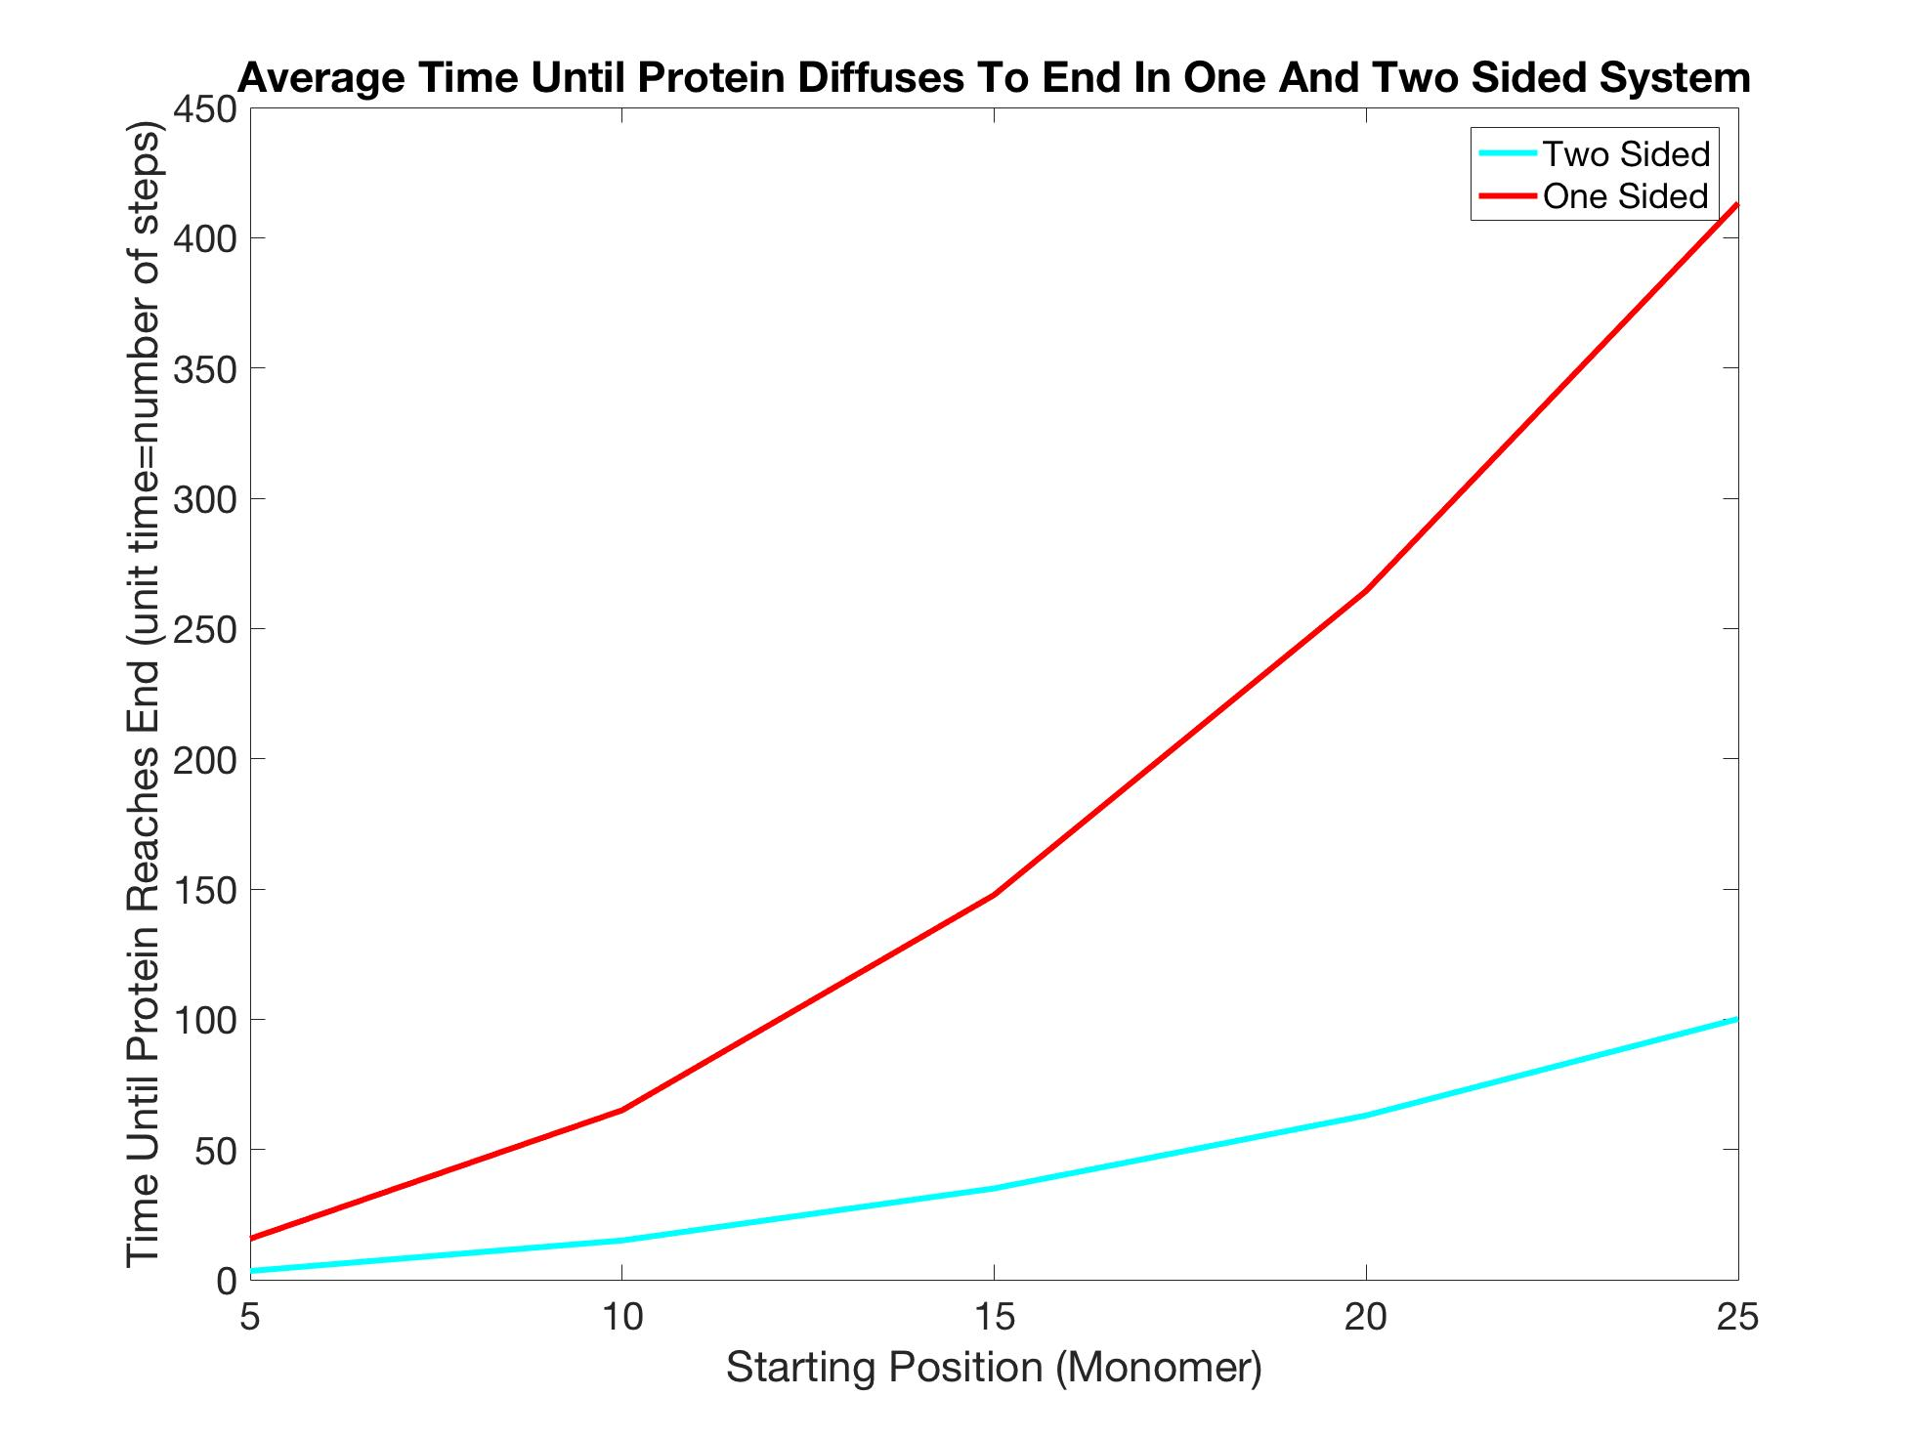
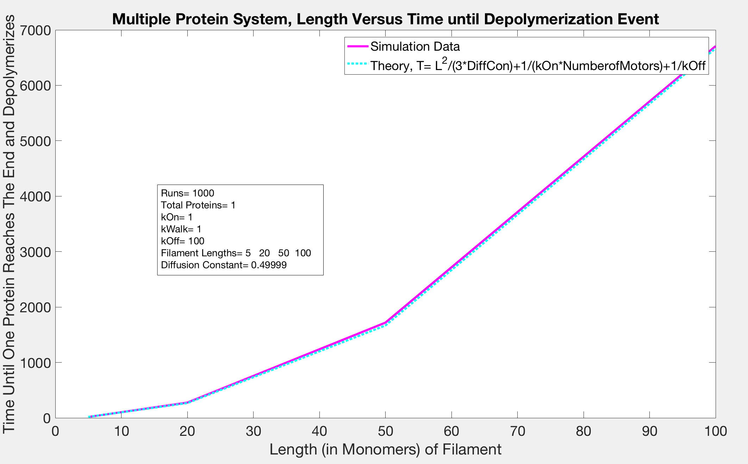
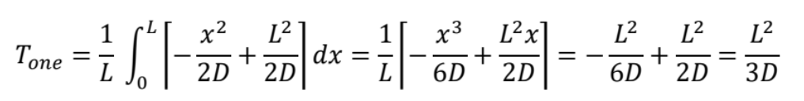
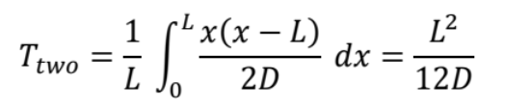
+
+
T (0n)
T (Diffuse)
T (Off)
=
T
Length of Filament (in monomers)
The simulation was consistent with our calculations when there was only one protein in the system

Slide 9
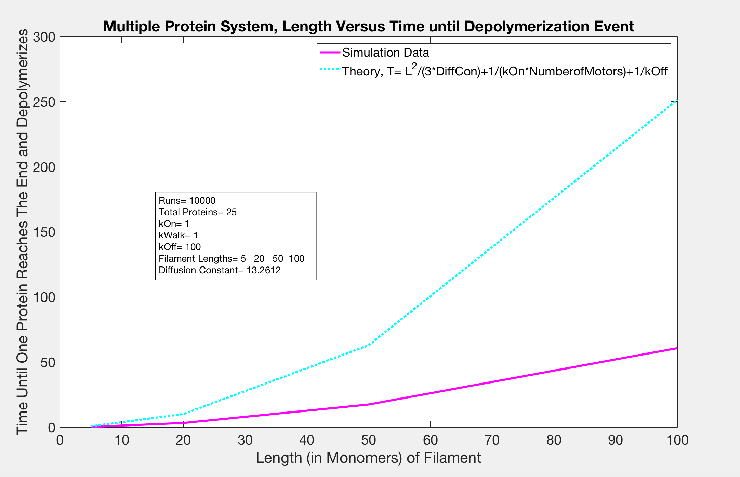
Once we added more than one protein to the system, our calculations were no longer consistent

Slide 10
NOW
We are looking at a system as it depolymerizes multiple times
We have to come up with new calculations to describe what we see
Th following graphs show how quickly filaments shrink with different lengths and concentrations

Slide 11
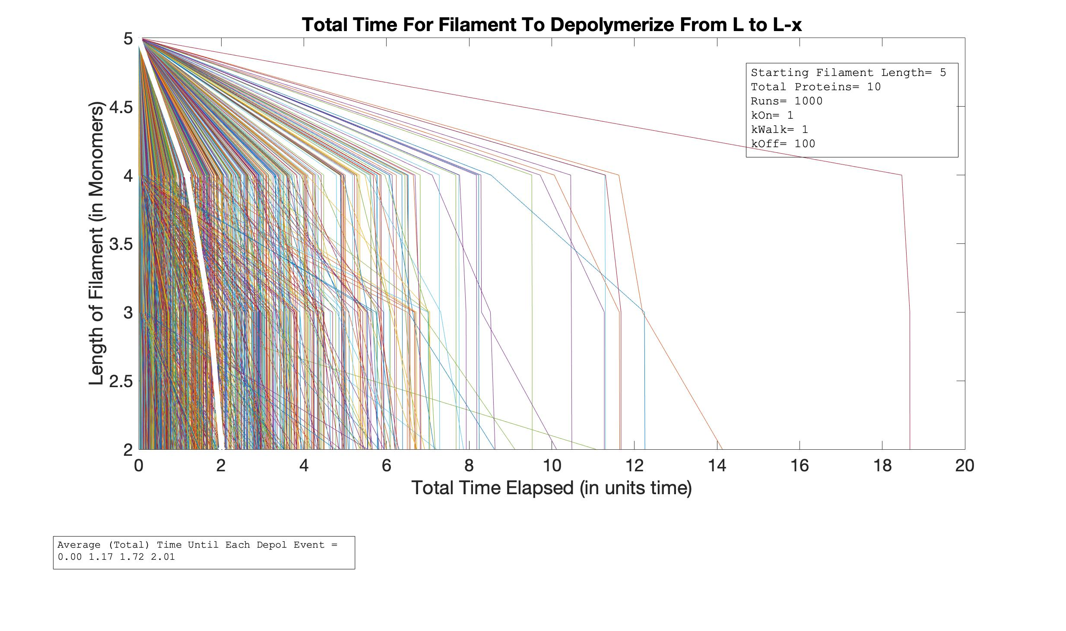
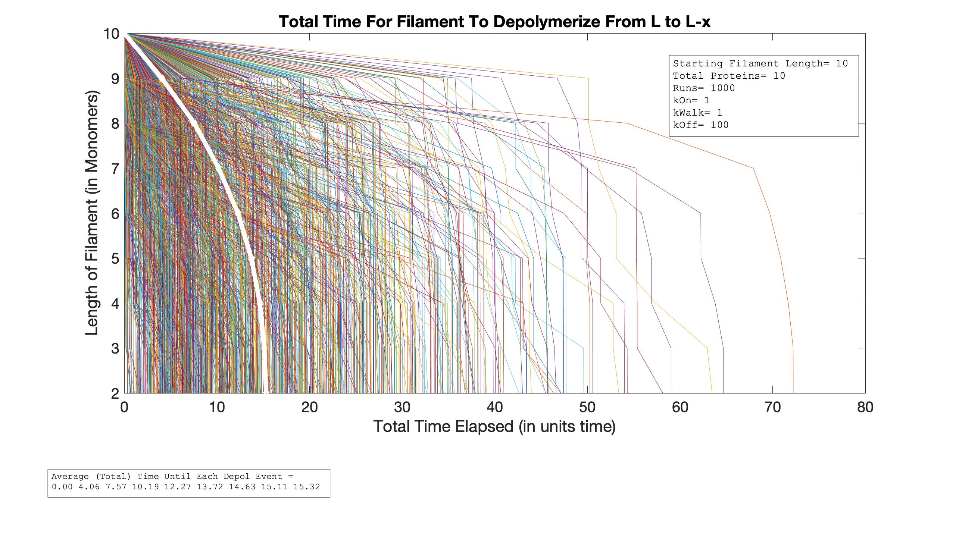
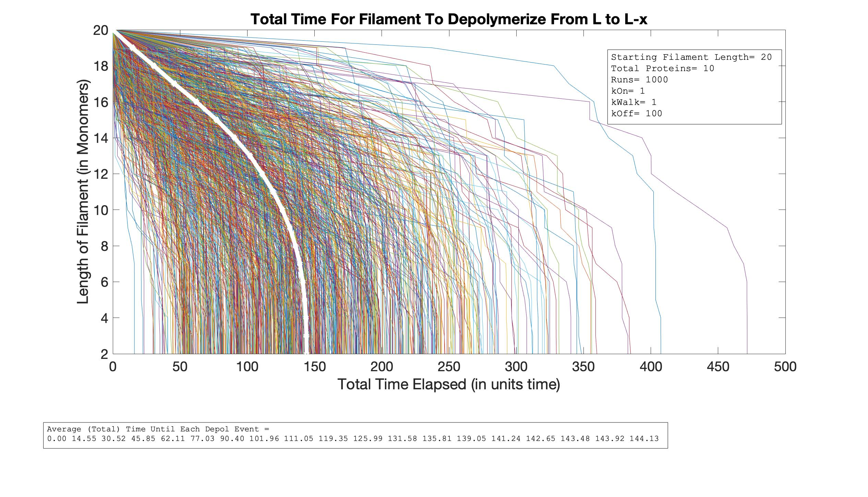
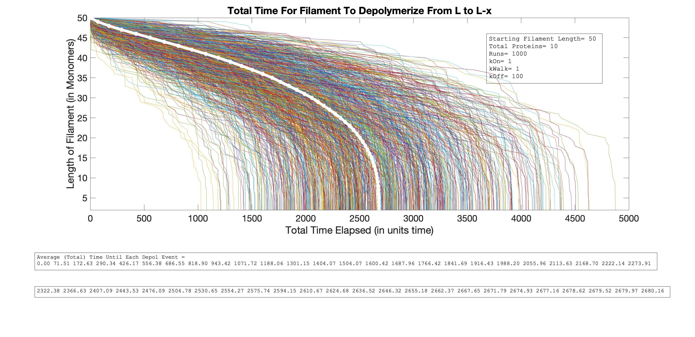
Total Time vs. Length
As L Increases

Slide 12
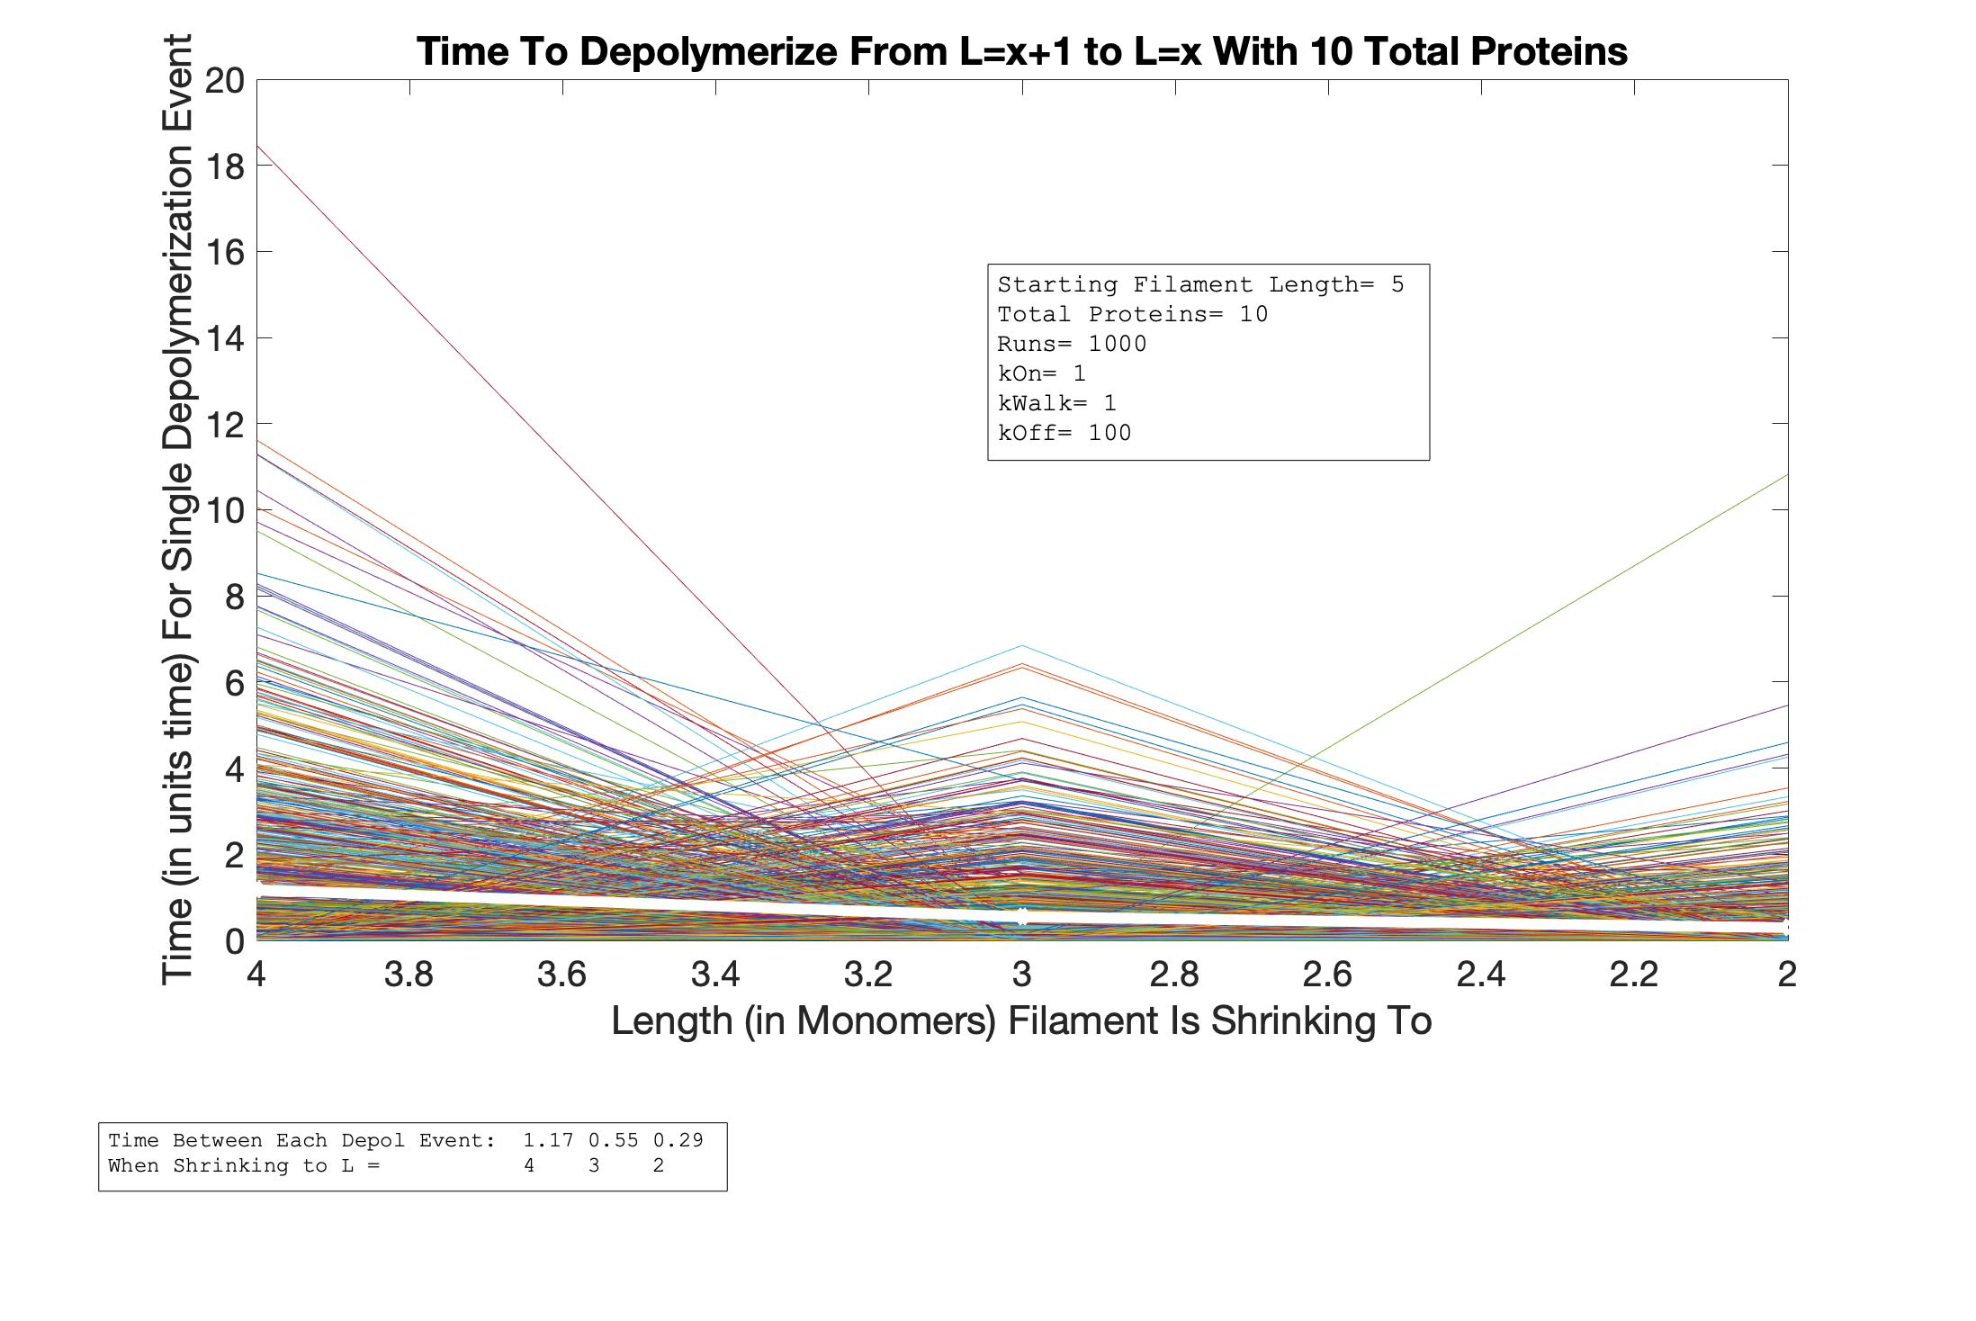
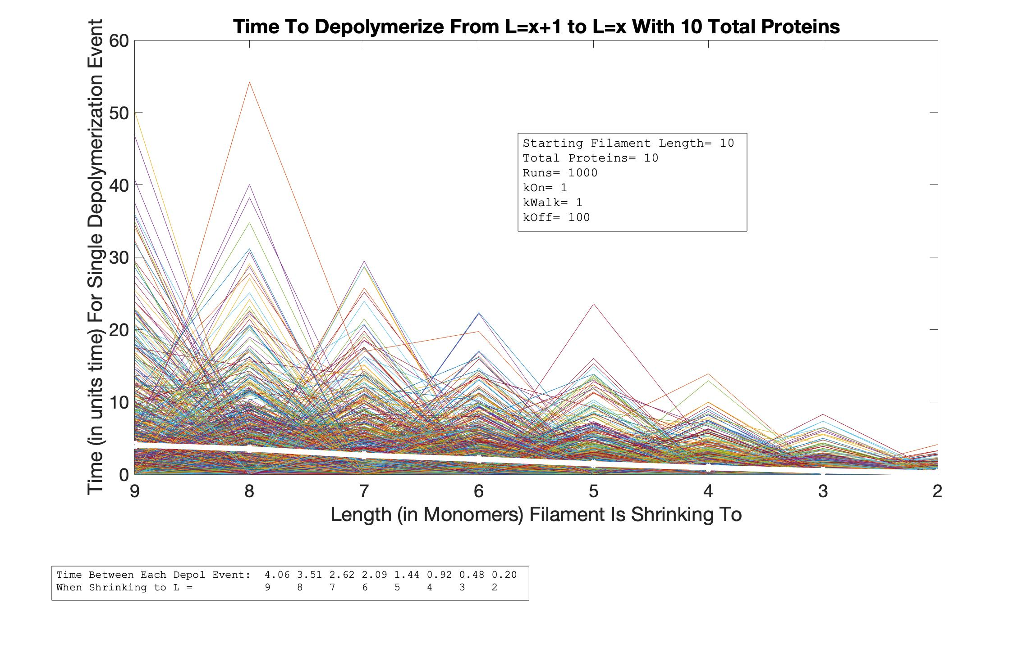
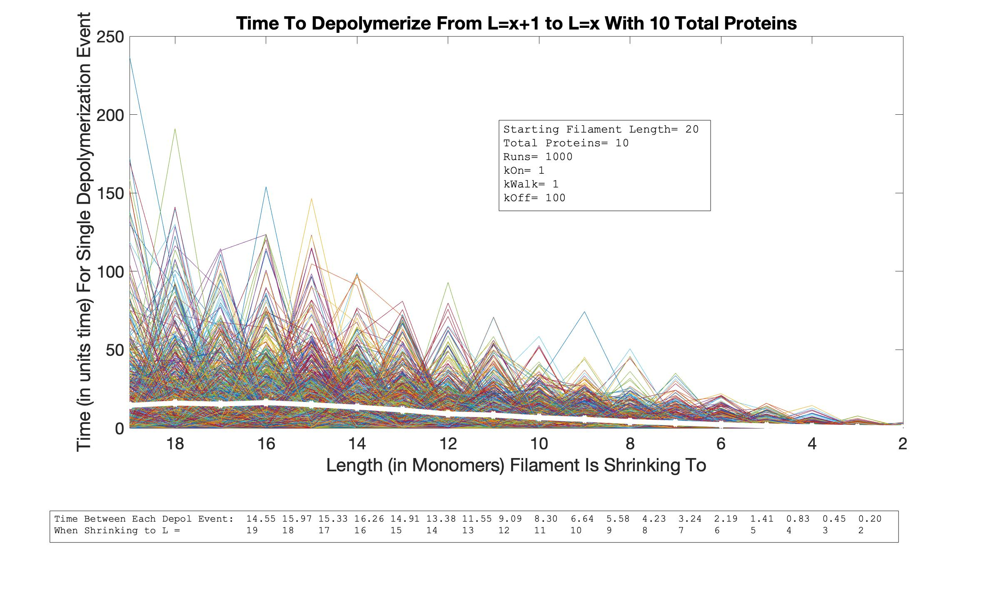
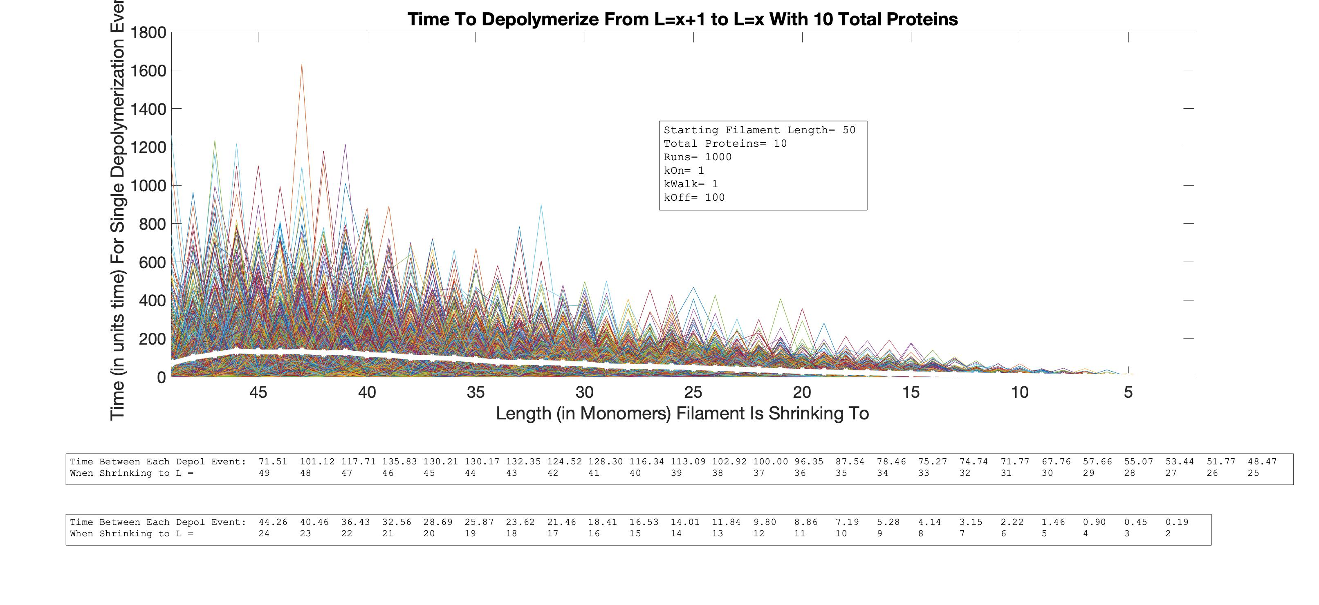
Single Depol Event Time vs. Length
As L Increases

Slide 13
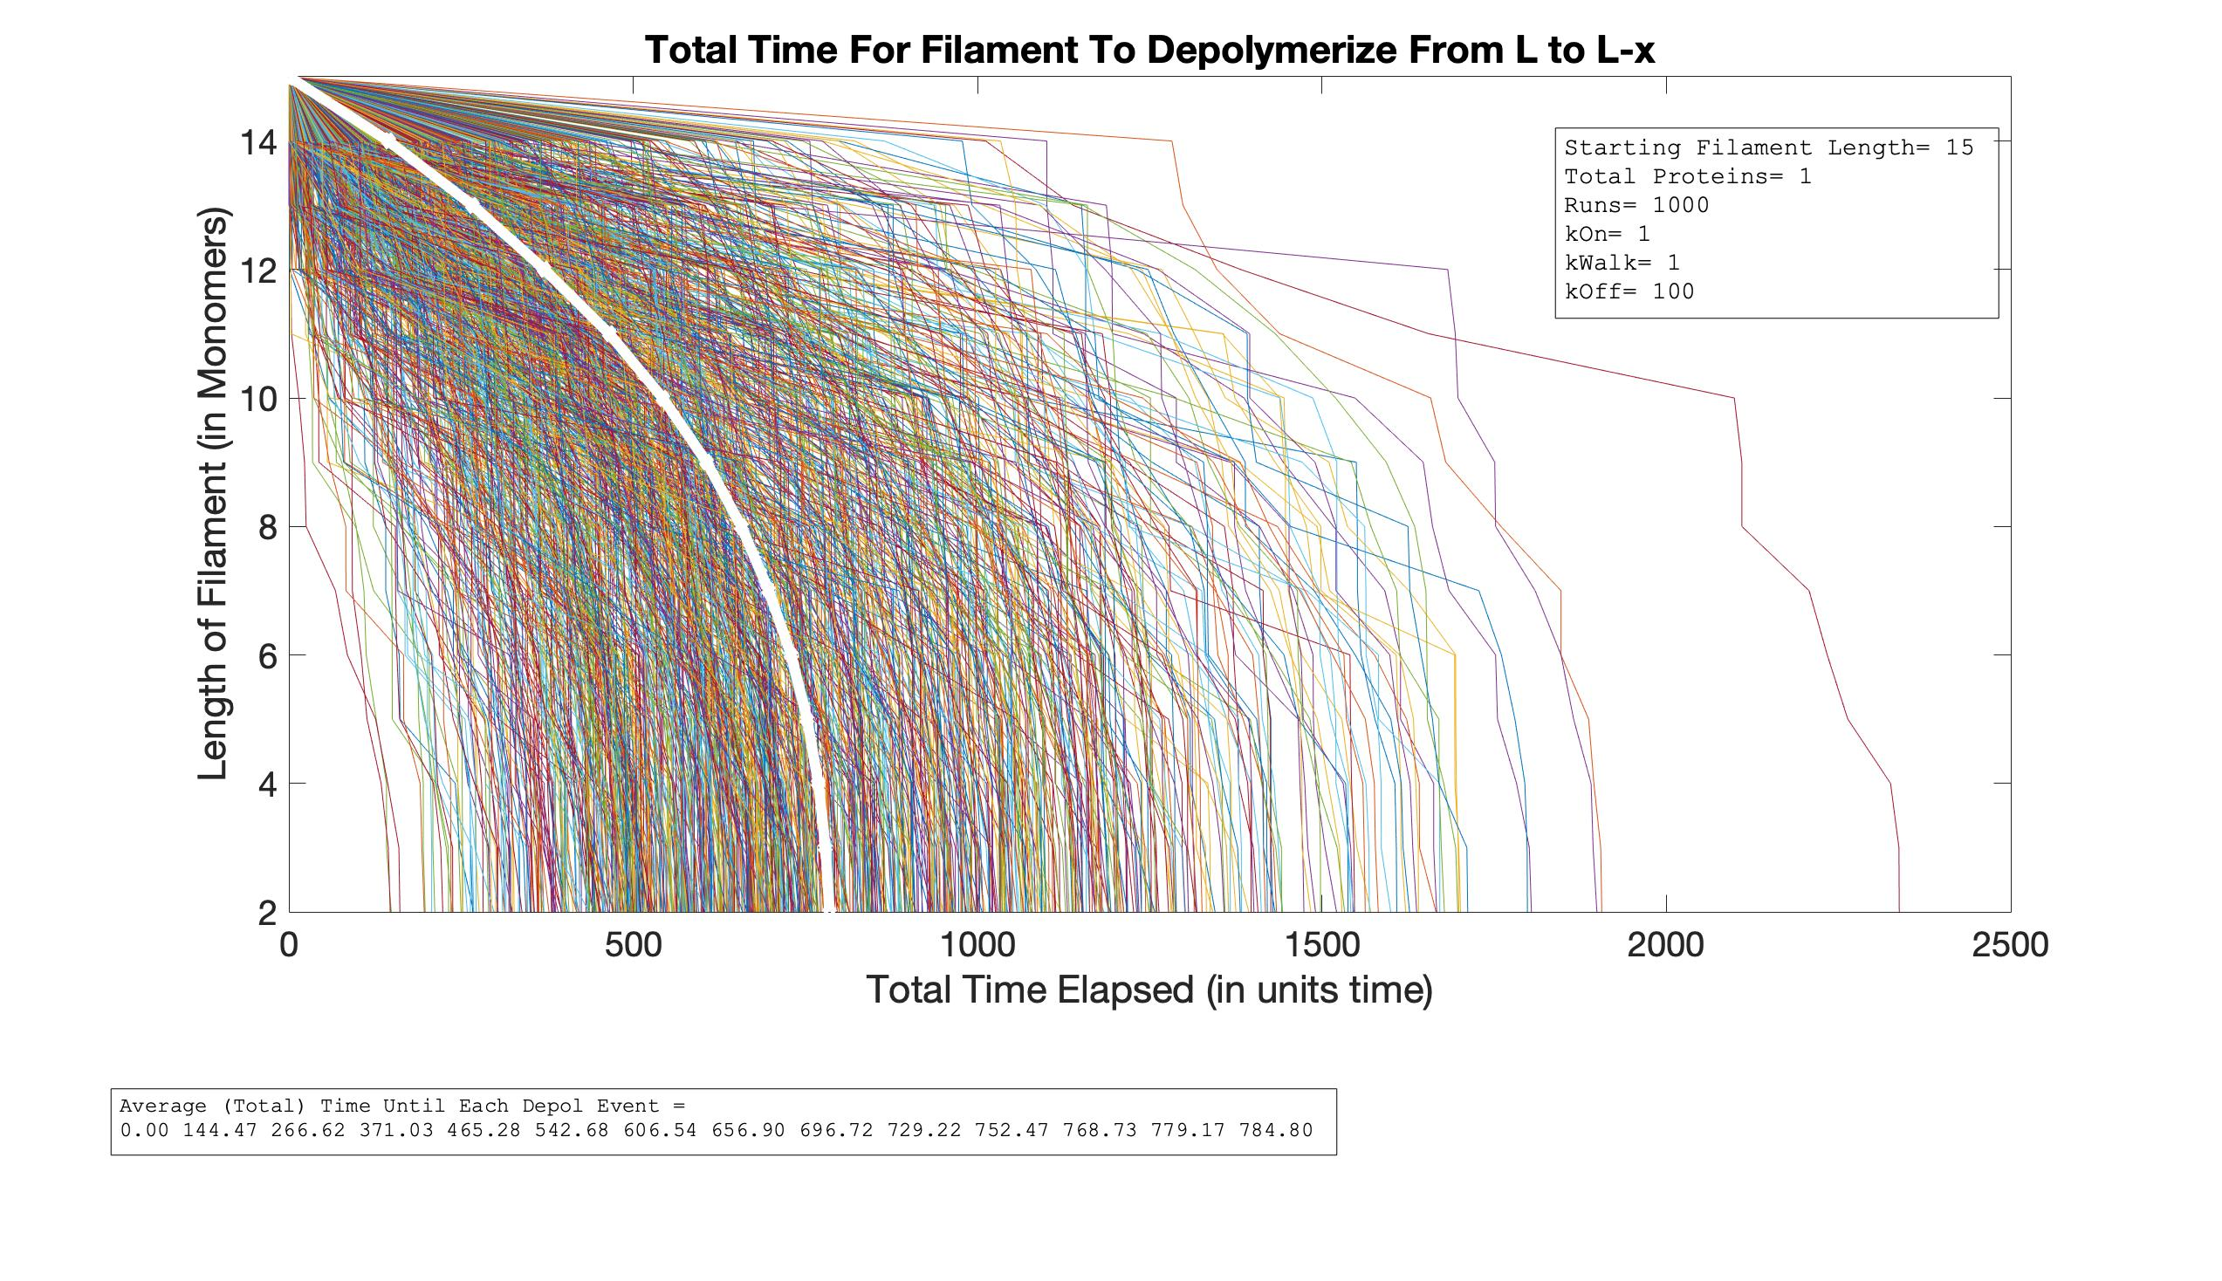
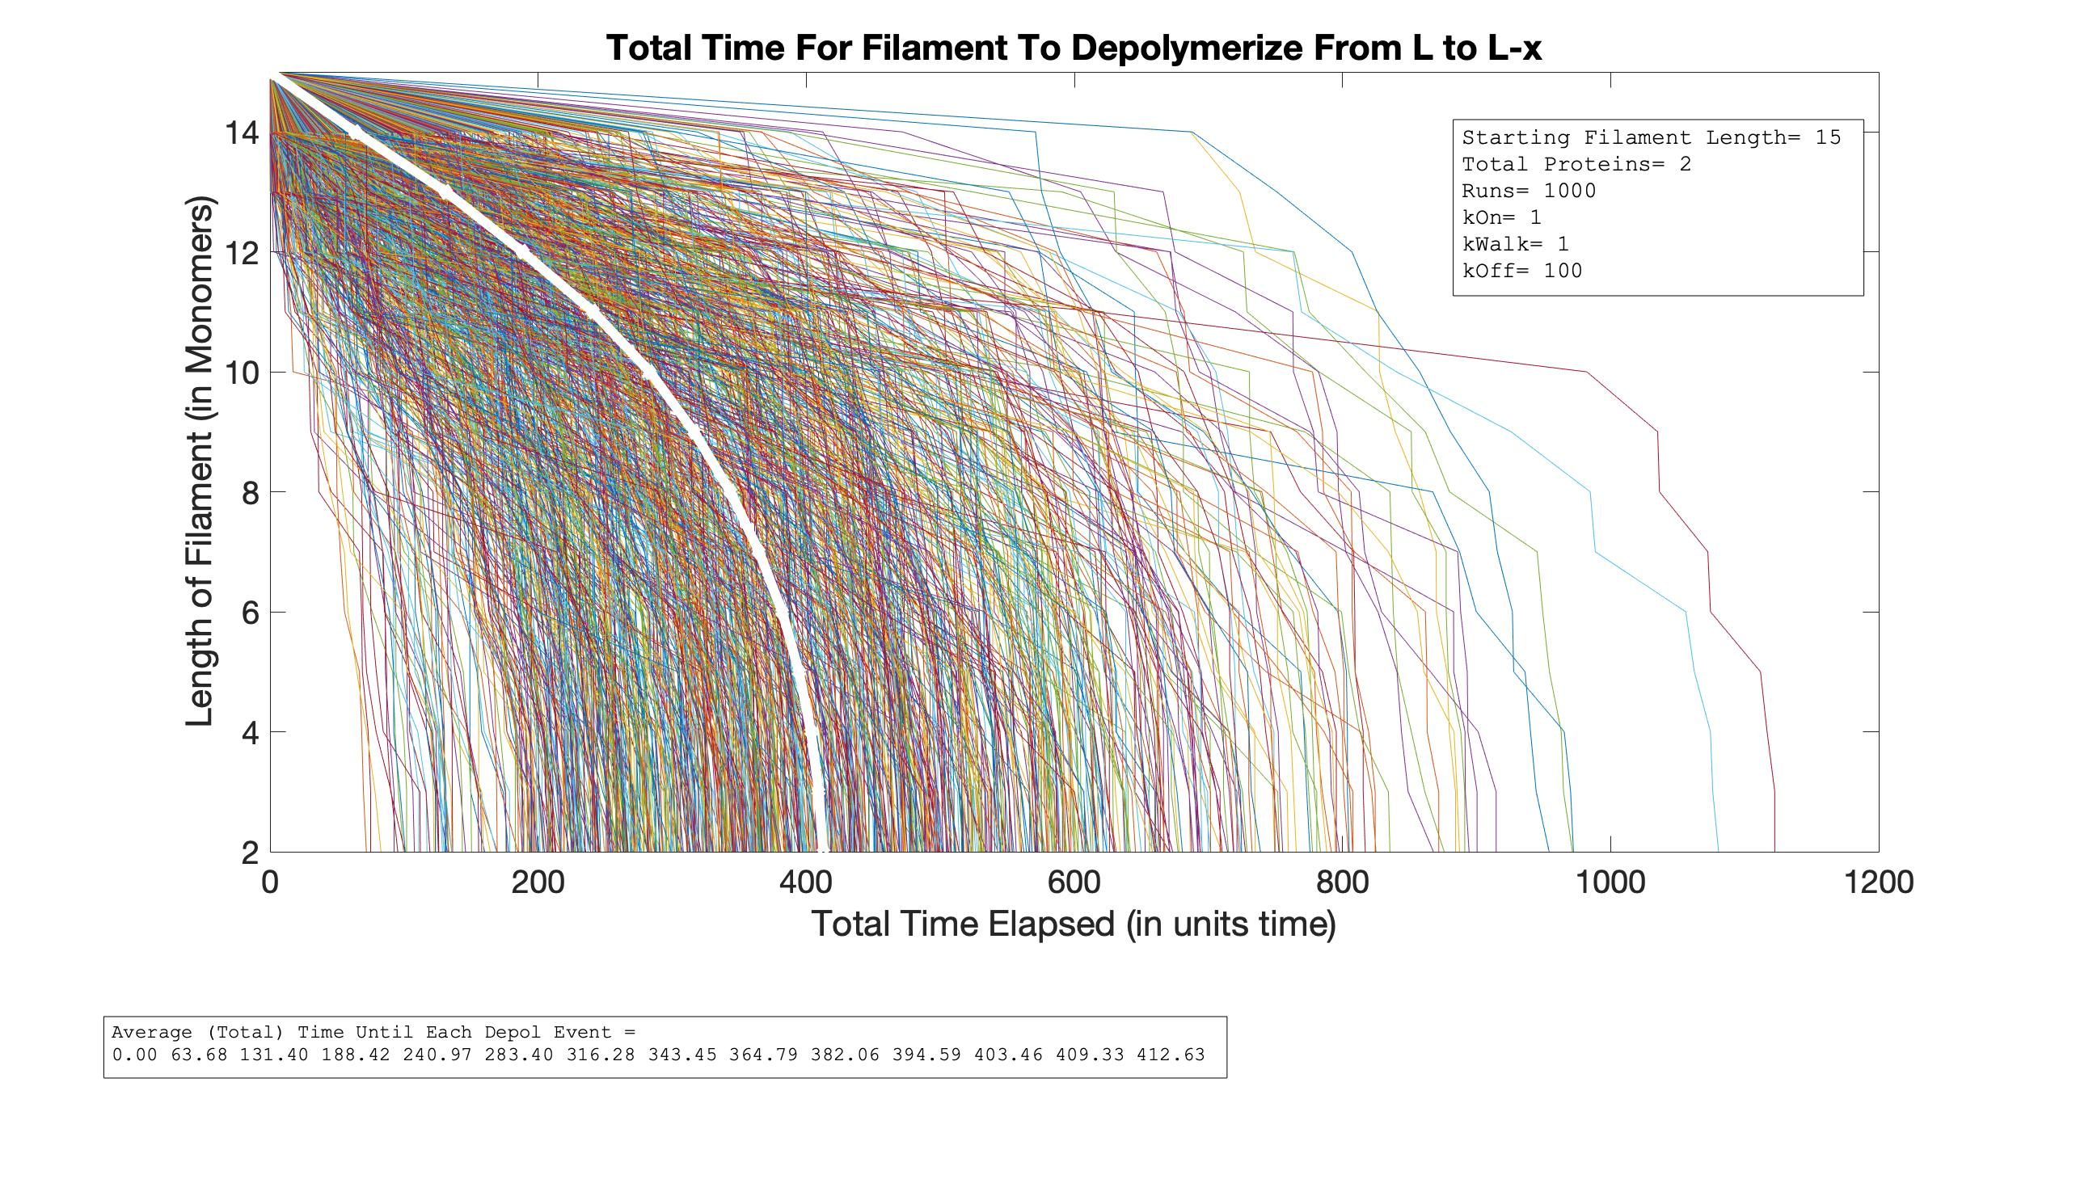
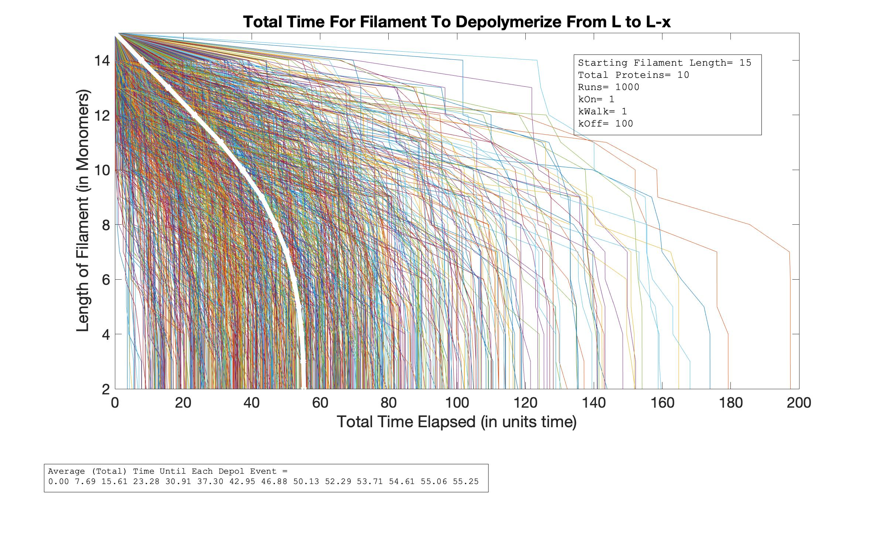

Total Time vs. Length
As P Increases

Slide 14
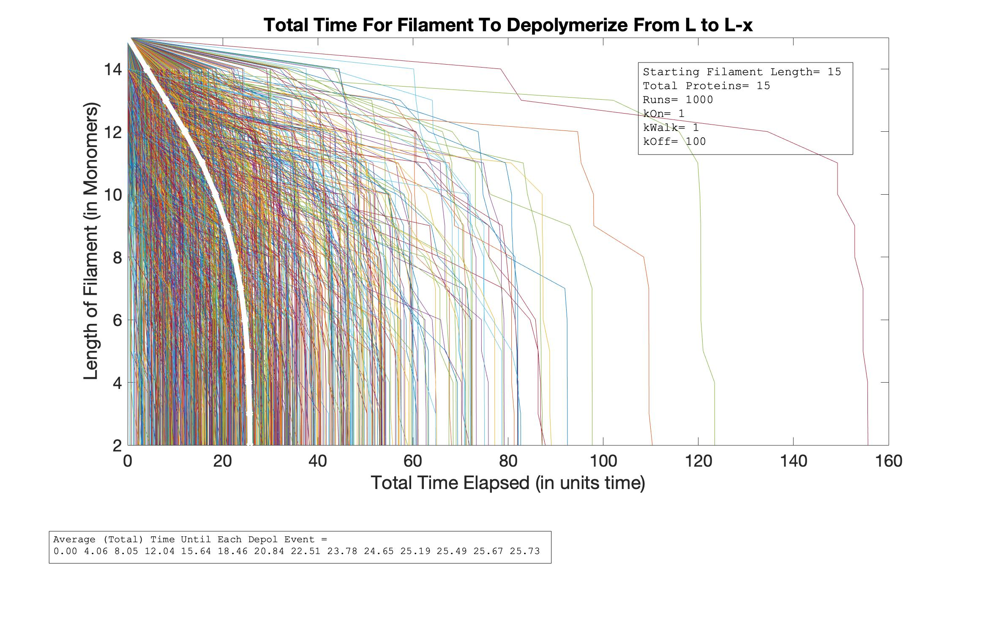
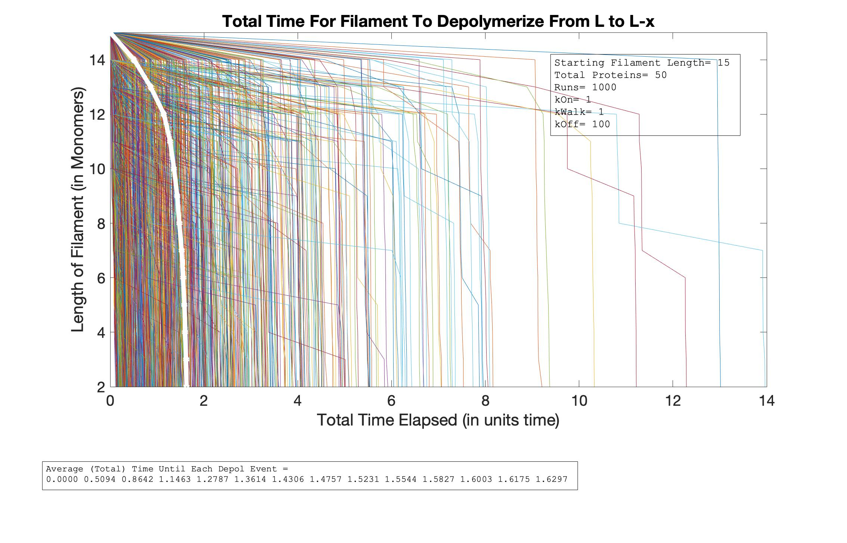
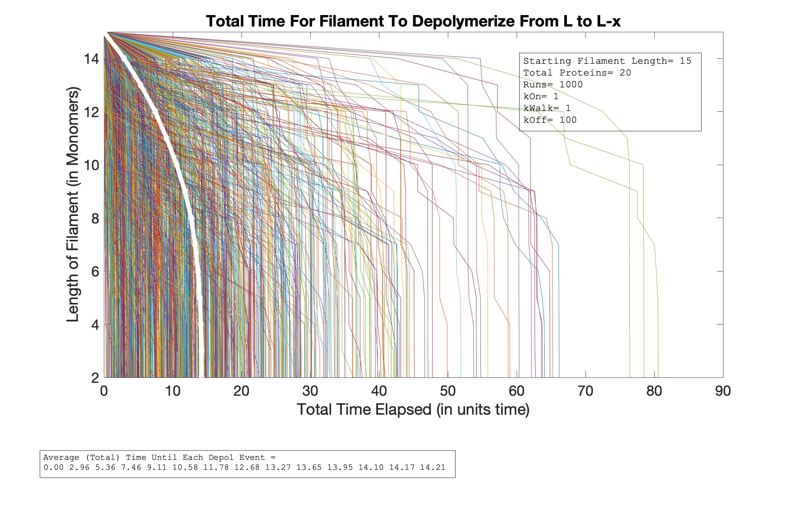
Total Time vs. Length
As P Increases

Slide 15
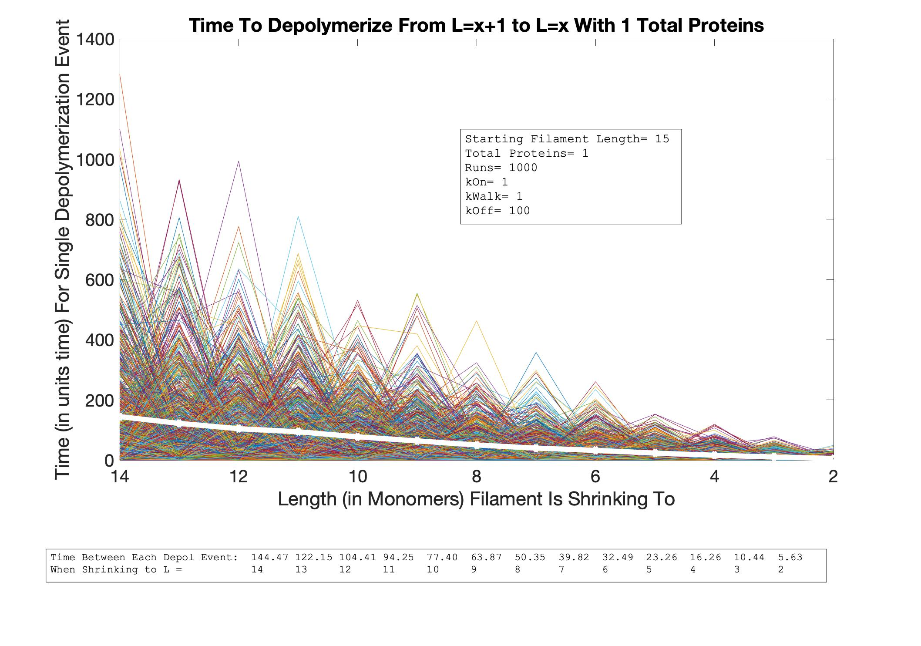
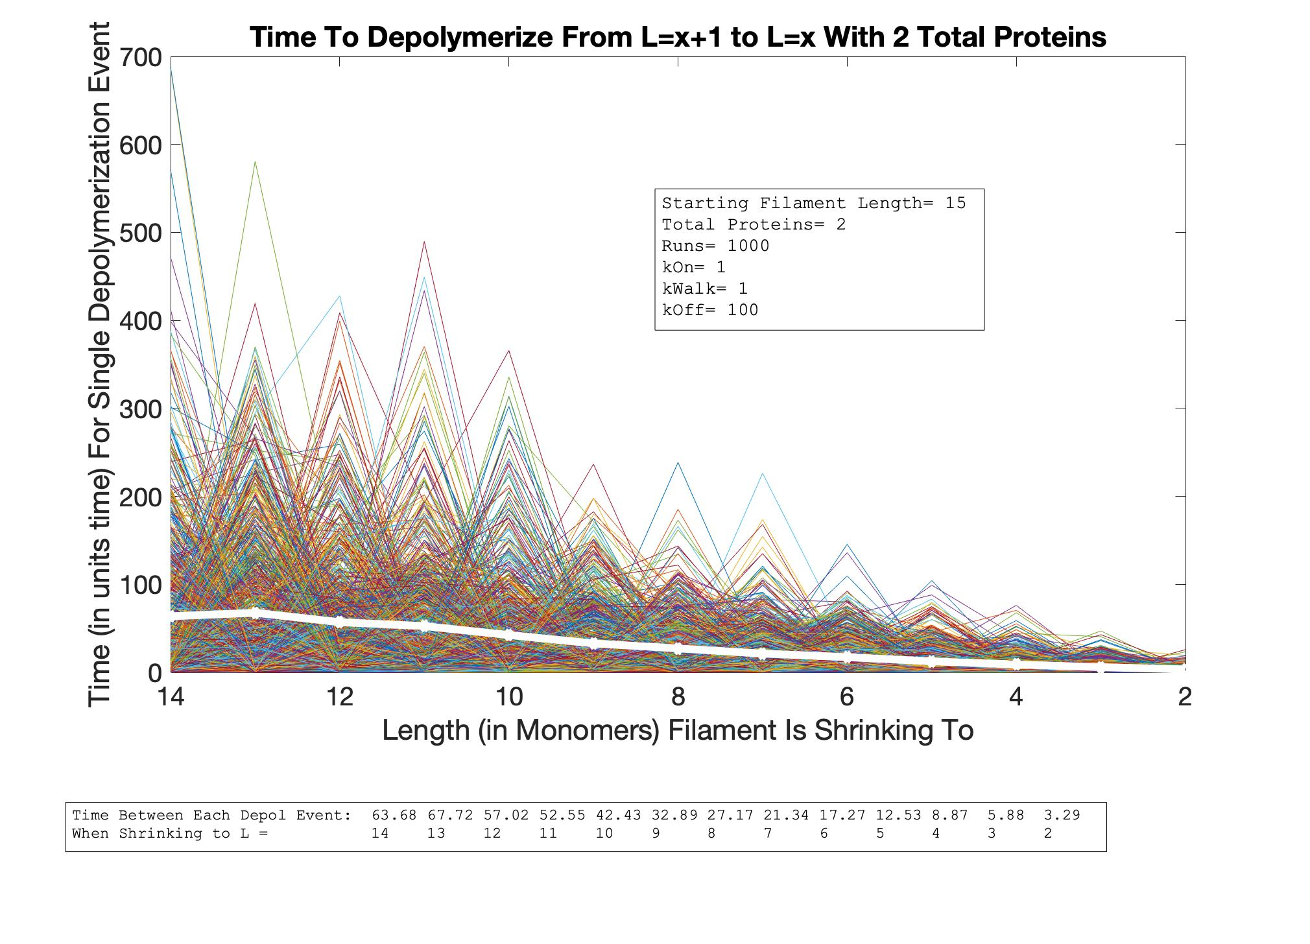
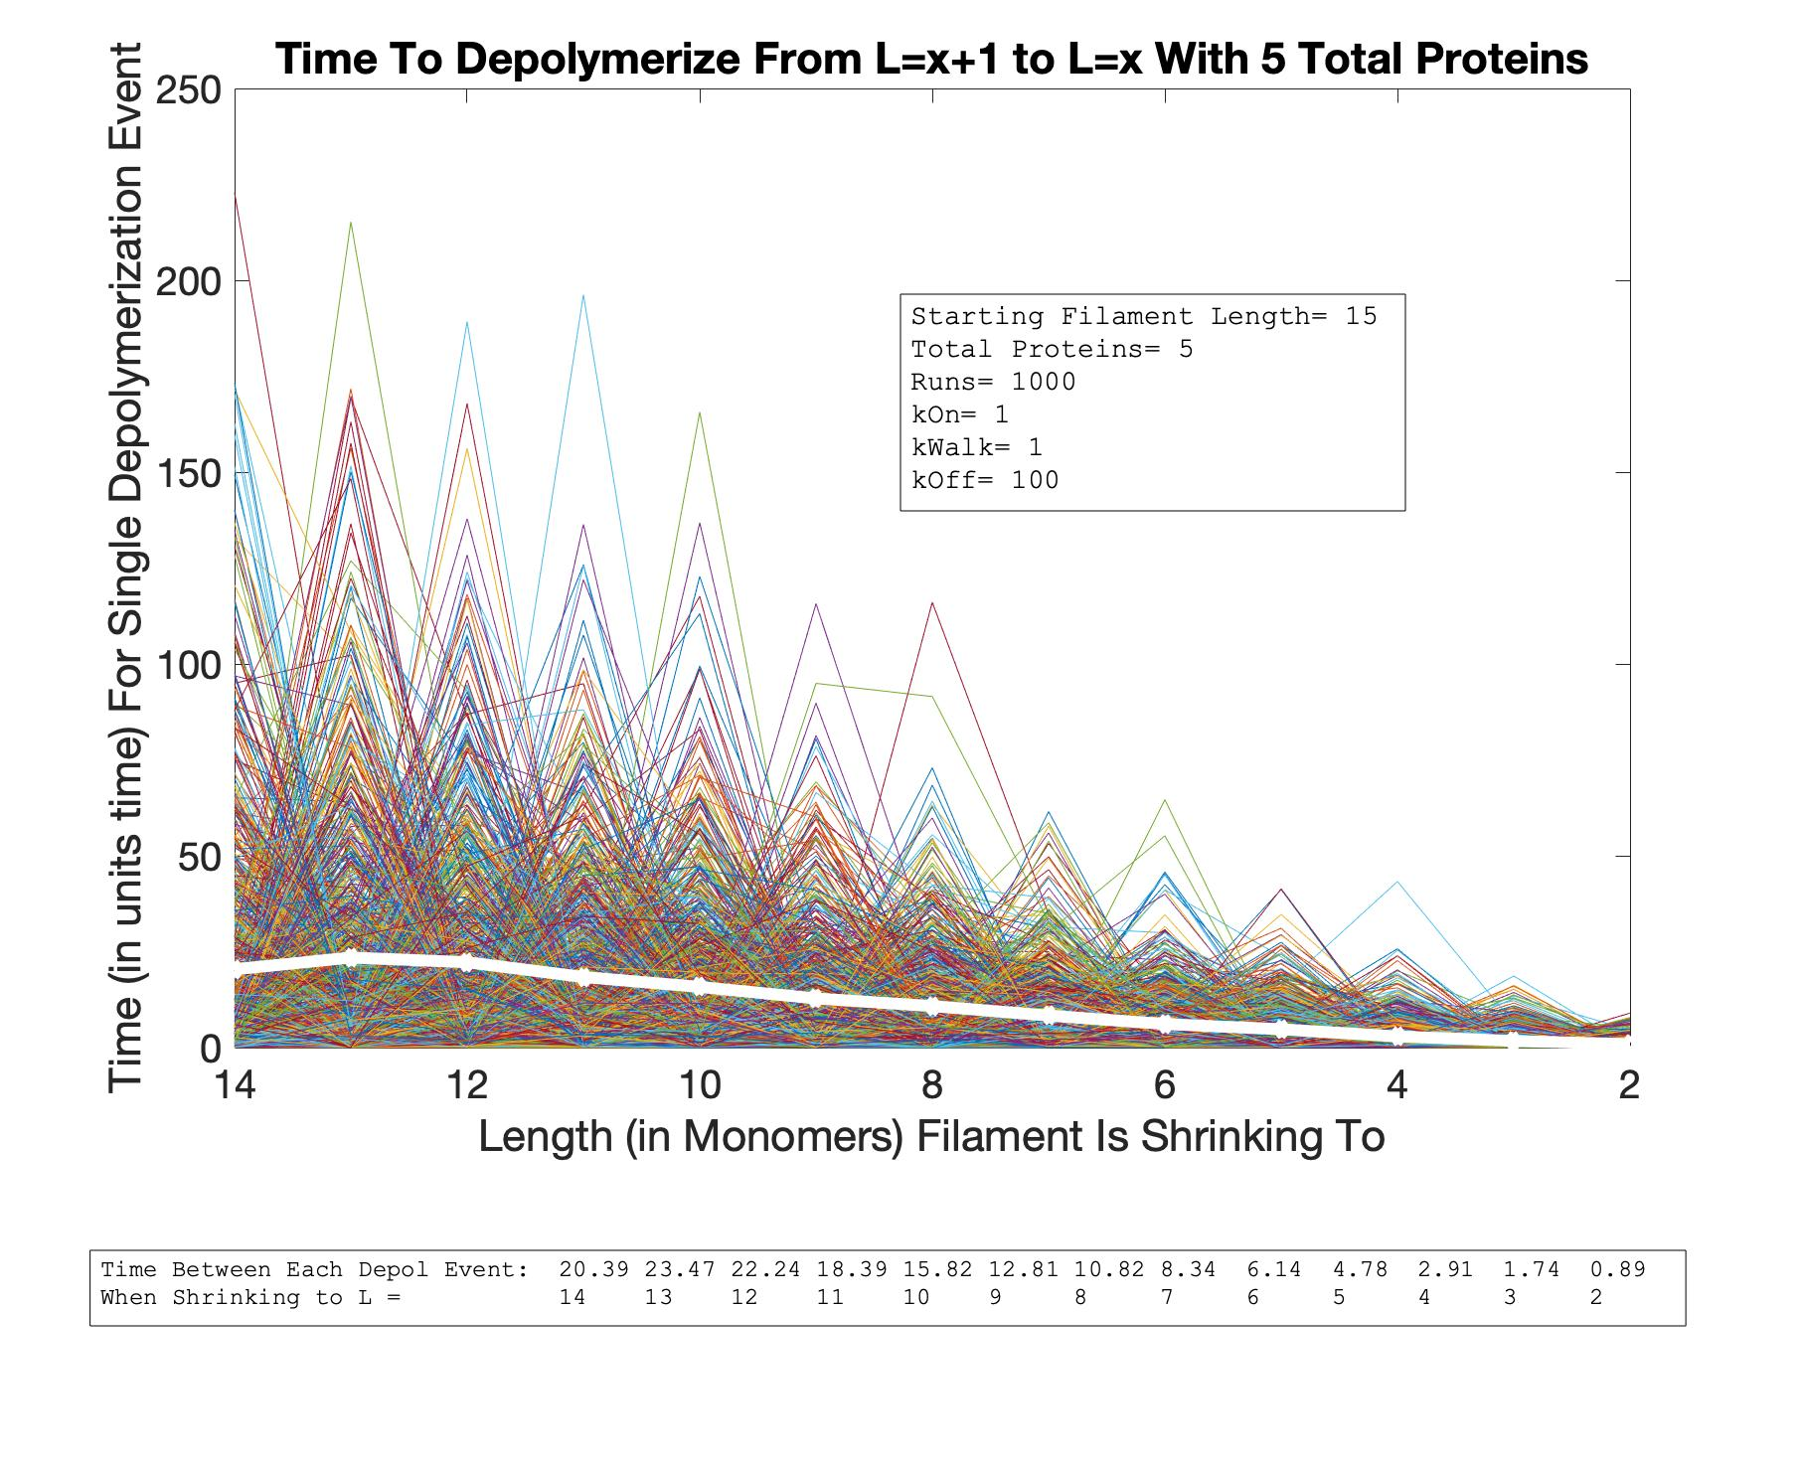
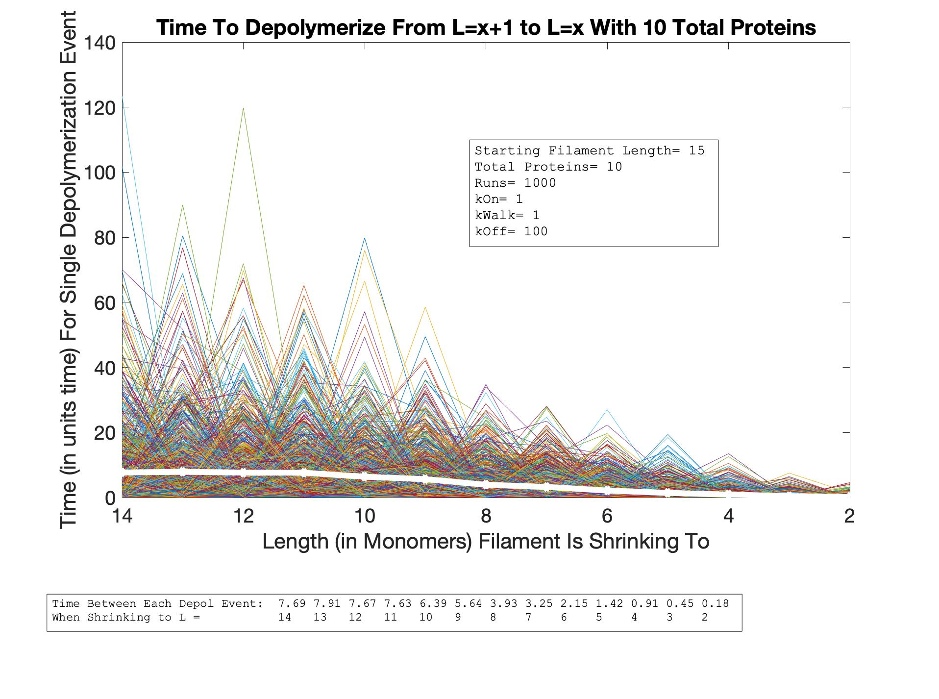
Single Depol Event Time vs. Length
As P Increases

Slide 16
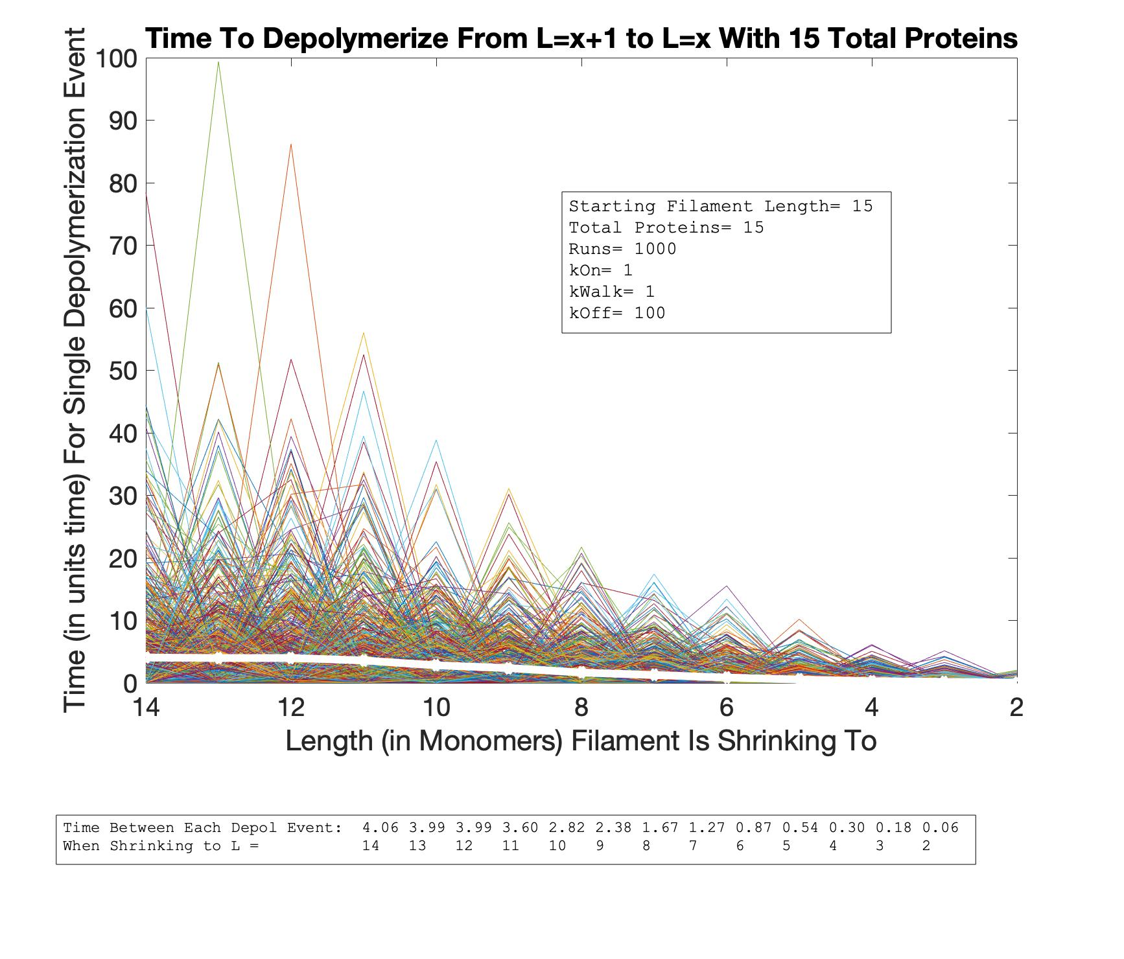

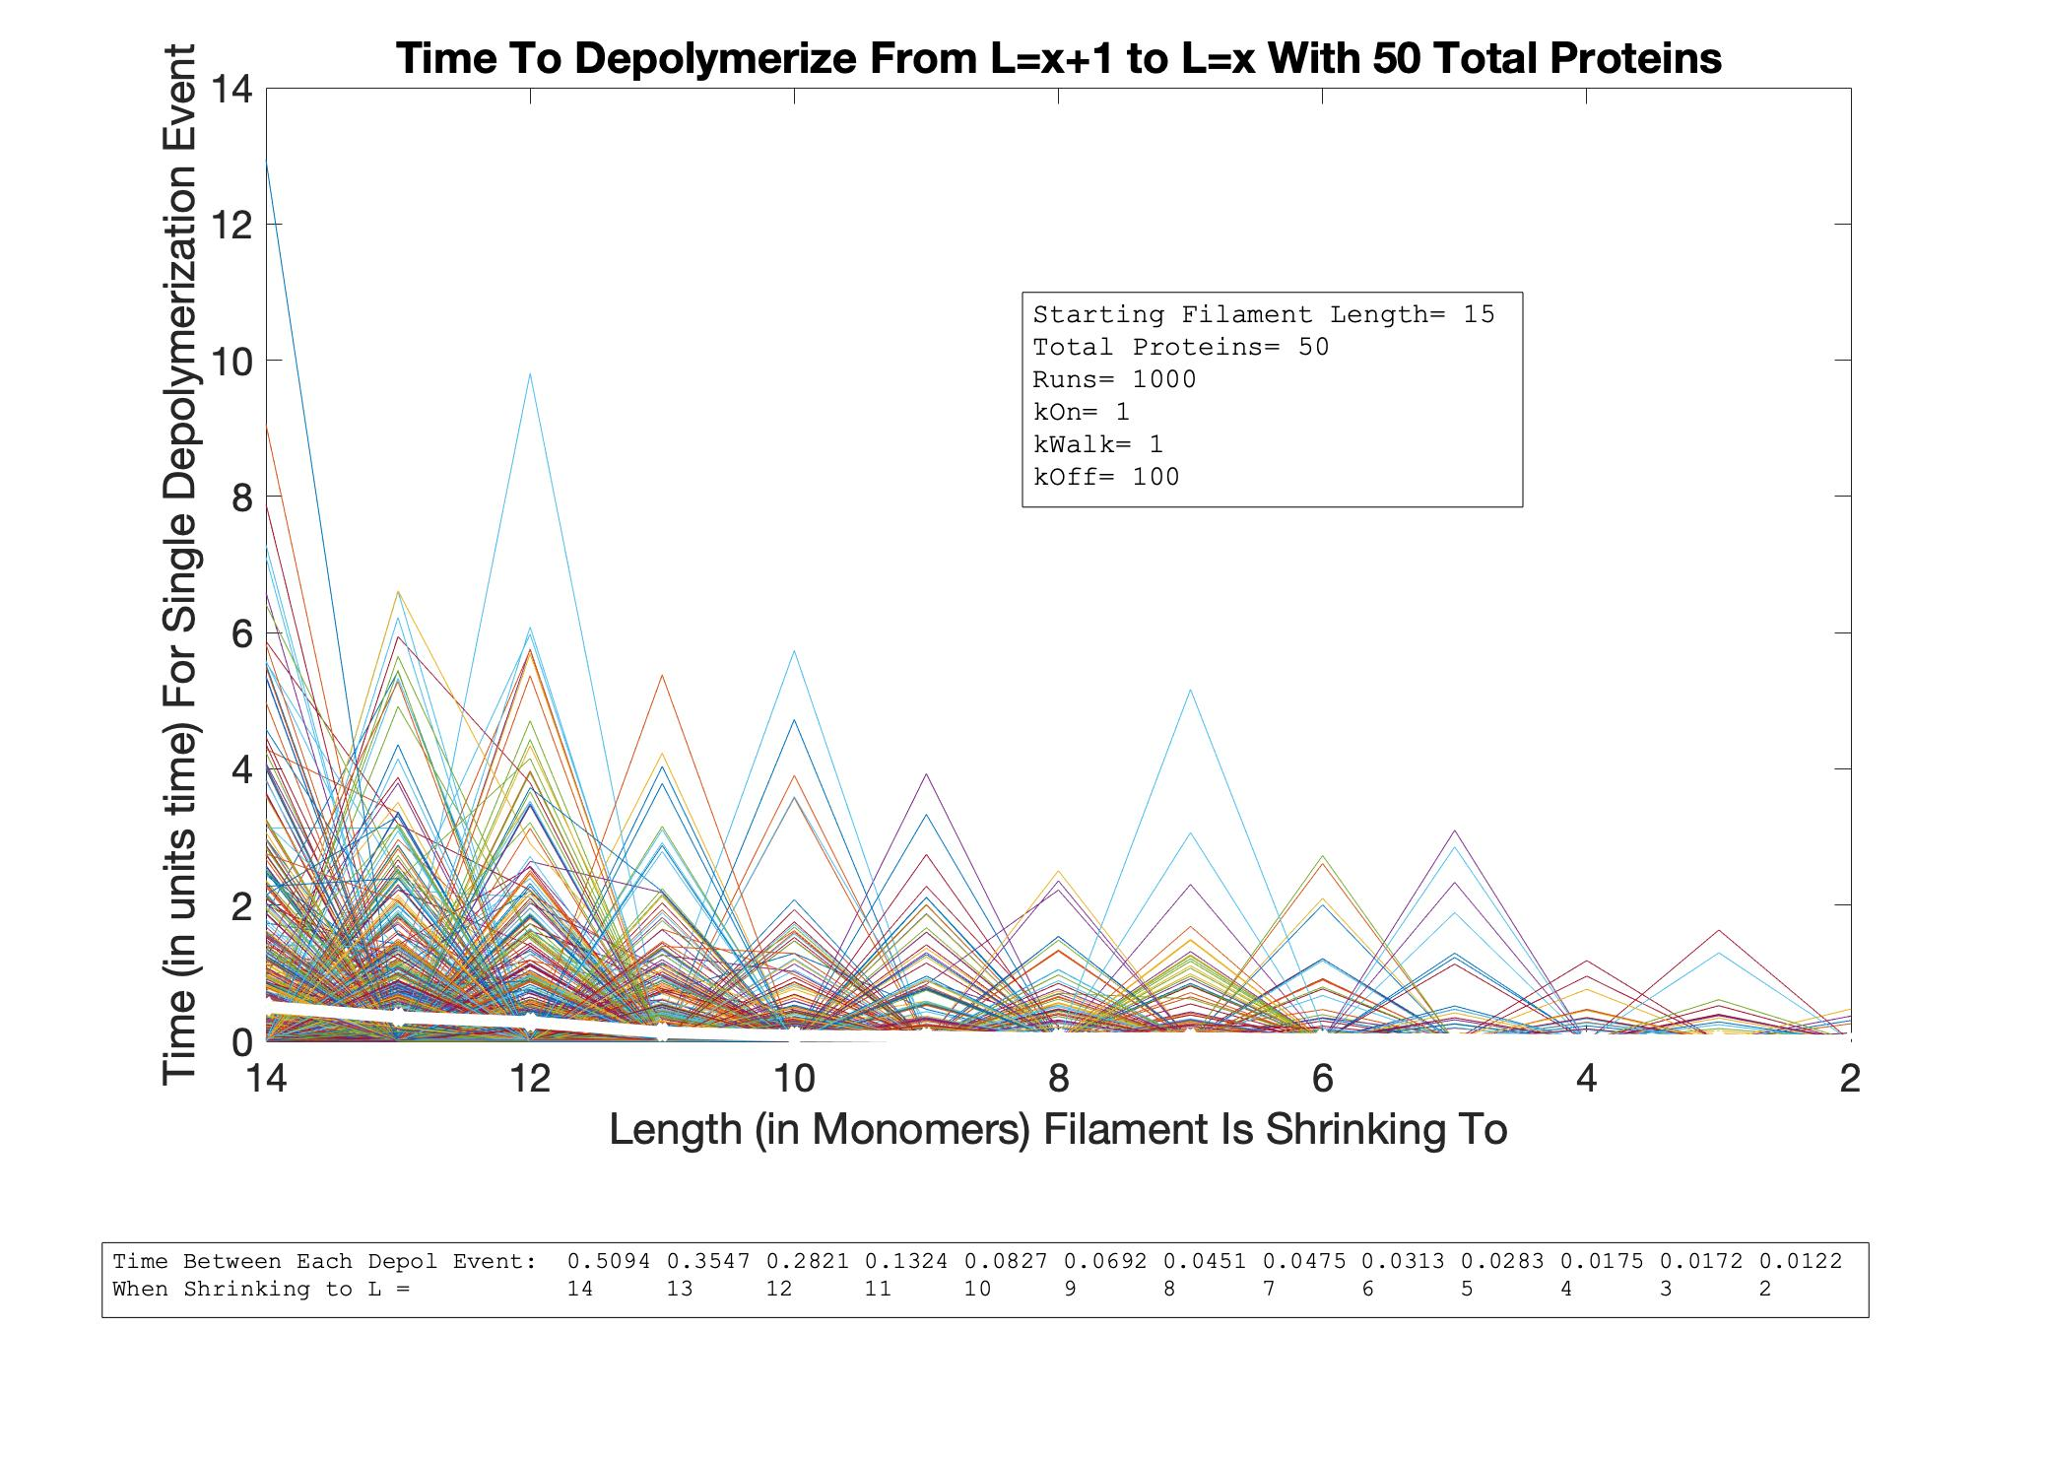
Single Depol Event Time vs. Length
As P Increases

